Slide 1
BoozyAnalytics
A Real-Time Mobile Survey of Alcohol Use and Sexual Consent in Social Research Participants
Samiksha Mailarpwar
Alex Lambrecht

Slide 2
AGENDA
Background and Motivation
Timeline
BoozyMeter
BoozyAnalytics Details
Demo
Technical Architecture
Technical Challenges

Slide 3
Background
Dr. Enbal Shacham (School of Public Health and Social Justice)
Real-time collection of alcohol use and sexual consent
Data Analysis of Reported Data
Mobile App Survey (Android) - Capstone I
Web-Facing Portal for Researcher - Capstone II

Slide 4
Use Cases
Researcher can collect data on:
Alcohol use on Campus
Sexual Consent*
Researcher can use Analysis of data:
Improve future studies
Collect more data
Improve university policies

Slide 5
Motivation?
Addresses a Public Health issue
Current research relies on old surveying methods
Participants respond days after drinking episodes
Inaccurate data surveying
Goal: report behavioral data in realtime

Slide 6
Timeline
Deliverable 4:
Working version of updated app, web-facing portal, and Excel Analytics Workbook
Pilot App
May 11
Deliverable 2:
Functioning App
app used for data gathering
August 9
Deliverable 1:
Location
Communication with cloud/server
Time Stamp
UI Sketches
June 30
Deliverable 3:
User-facing layout
web element
App Updates
Excel alpha version
March 2

Slide 7
Basic Features of BoozyMeter
User can…
report type of drink
number of drinks
size of drink
Other Questions proposed by Researcher
App…
Tracks location/time
Logs Answers to questions
Prompts morning questionnaire

Slide 8
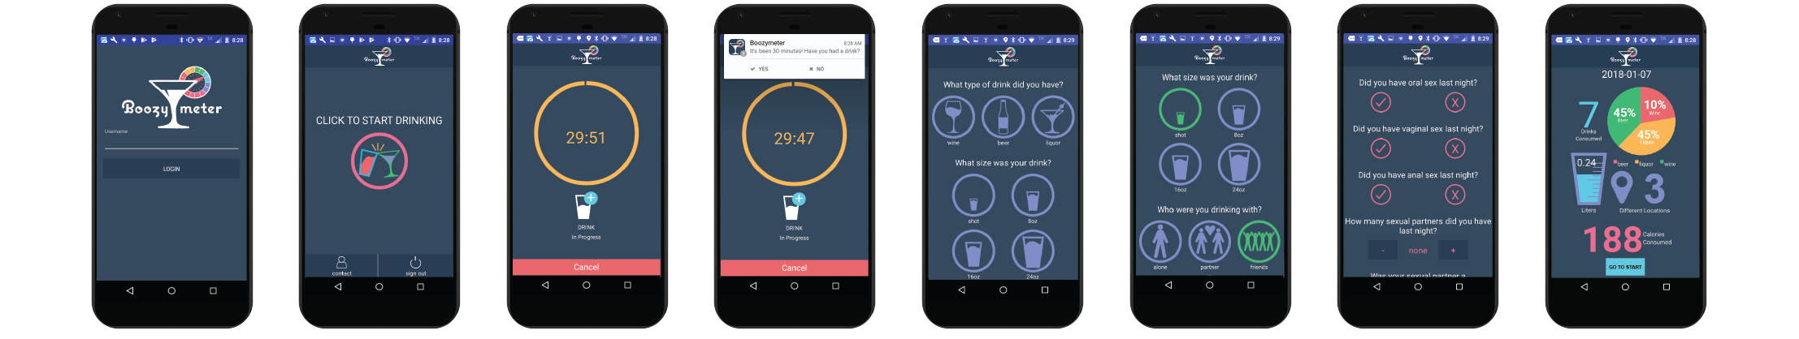

Slide 9
Basic Features of BoozyAnalytics
Webpage…
Admin portal for BoozyMeter
User management capabilities (add/delete)
Control/Experimental Group Management
Exporting Data
Live Dashboard
Individual Participant Activity Analysis
Excel Analytics Workbook…
Merge Raw and Demographic data
Perform basic filtering analyses

Slide 10
Deliverable 3 Details
Website with all core features:
Admin Authentication
Data Filtering and Export
User Management
Realtime data population
Excel Analytics Workbook
Code for File Picker
BoozyMeter Mobile App:
Code updates

Slide 11
DEMO

Slide 12
Deliverable 4 Vision
BoozyAnalytics extra features (website):
Realtime Dashboard
Individual user analyses
Excel Analytics Workbook:
Combined data table
Filtered tabs
BoozyMeter Mobile App:
Control vs. Experimental participants
Pilot Study

Slide 13
Technical Architecture

Slide 14

Platform
BoozyMeter: Android (mobile)
AngularJS, HTML, CSS (web)
Yeomen generator for AngularJS structure

Slide 15

Firebase
Google’s mobile/web platform
Features:
real-time database (JSON tree)
authentication database
test-lab for Android (cloud-based infrastructure testing)
Secure File Storage

Slide 16

Excel Analytics Workbook
Why?
Powerful tool
Used by most researchers
Built in functions

Slide 17
Technical Challenges

Slide 18
Challenge 1
BoozyMeter first, BoozyAnalytics later
Challenge: Forced to make SW choices made for BoozyMeter work for BoozyAnalytics
Ideal for this project: side by side development

Slide 19
Challenge 2:
Steep learning curve
Angular-Fire requires specific structure
Challenge: no time to plan/research due to time crunch

Slide 20
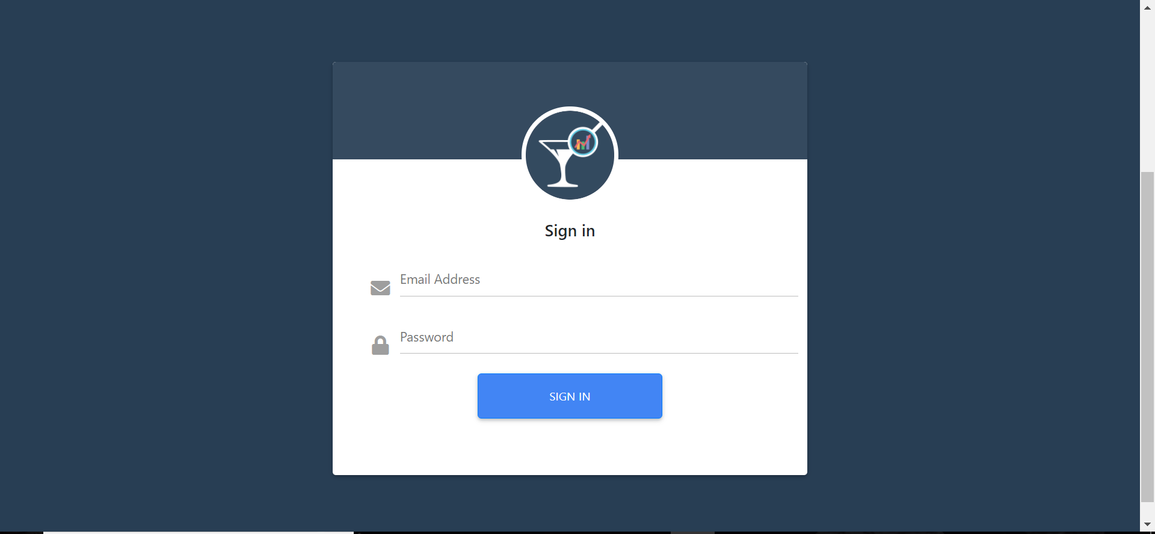

Slide 21
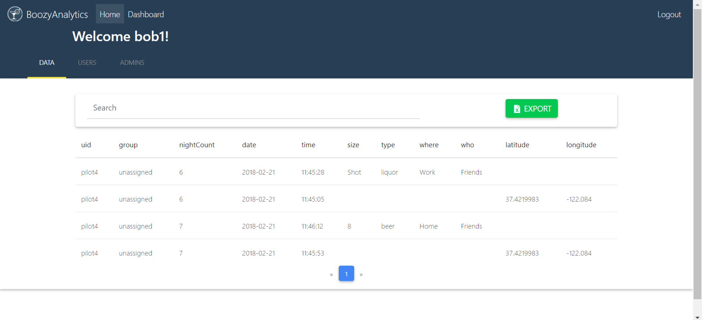

Slide 22
